Slide 1
Creativity Works!
Achievements so far

Slide 2
Political Context

Slide 3
A complex institutional set-up
Unique legislative system, incomparable to a typical government
Engaging with the EU means working on more than one front and requires a coherent message
State leaders of European member states and the President of the European Commission set priorities, the European Parliament is co-legislator
Copyright and the digital single market top policy priority for the coming 5 years

Slide 4
Brussels players
Coalition
Industry
Law firms
Companies
Third countries
European Commission
Trade unions
European Parliament
Council
International organisations
Media
Consumers & NGOs
Think tanks

Slide 5
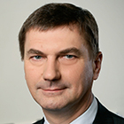
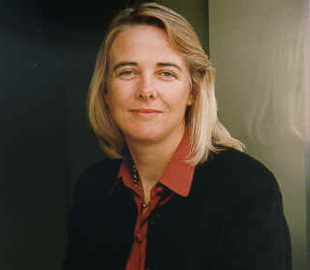
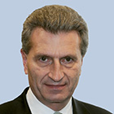
Who runs the show in the European Commission…
Jean-Claude Juncker
President of the European Commission
Frans Timmermans
VP, Better Regulation
Andrus Ansip
VP, Digital Single Market
Catherine Day
Secretariat general
Martin Selmayr
Mr Juncker’s head of cabinet
Günther Oettinger
Digital economy & society

Slide 6
… and what about the EP and the Council?
The European Council brings together all 28 EU Member States, meaning 28 different policy priorities and positions which eventually need to agree on one solution
Various diverging opinions on culture and copyright, which requires a coherent message and unified players
The European Parliament has 751 members who represent their national and regional constituencies
Multiple committees deal with copyright-related matters
MEPs are sensitive to calls for stricter copyright enforcement, concerned they have restrictive effects on free speech and Internet freedom

Slide 7
Copyright – a policy priority
Modernising copyright for the digital age is one of the EU’s top policy priorities for 2015 and beyond
Cross-border access and portability, as well as User Generated Content main buzzwords
“We must modernise copyright rules in the light of the ongoing digital revolution“ – Jean-Claude Juncker, European Commission President
"I am against geo blocking, we have to review copyright legislation and we have to deal with territoriality principle. This is old fashioned“ – Andrus Ansip, Vice-President for Digital Single Market

Slide 8
The Creativity Works! coalition

Slide 9
Creativity Works!
Alliance of leading organisations from the European cultural and creative sectors representing the whole creative value chain
Members range from film directors, video games developers, broadcasters, writers, screenwriters and book publishers to sports organisations, picture agencies, music and TV and film producers, distributors and exhibitors

Slide 10
CW! membership
Notes:
Members include: Association of Commercial Televisions in Europe (ACT); Center of the Picture Industry (CEPIC); EUROCINEMA; European Coordination of Independent Producers (CEPI); European Writers’ Council (EWC); Federation of European Film Directors (FERA); Federation of European Publishers (FEP); Federation of Screenwriters in Europe (FSE); Independent Music Companies Association (IMPALA); Interactive Software Federation of Europe (ISFE); International Federation of Film Producers’ Associations (FIAPF); International Union of Cinemas (UNIC); International Video Federation (IVF); Motion Picture Association (MPA); International Confederation of Music Publishers (ICMP); Bundesliga; and the Premier League/Sports Rights Owners Coalition

Slide 11
What brings CW! together
Passionate belief in the importance of creativity, creative content, cultural diversity and freedom of expression
Shared vision for the internet that protects rights and freedoms for all and everyone
Keenness for an open dialogue with European decision-makers

Slide 12
Objective
Establish Creativity Works! as a creative, informative and credible voice
in the broader debate about culture, innovation, copyright and the digital economy for the EP, European Commission and Member States
Use Creativity Works! materials and activities to tell the story of Europe’s creative and cultural sectors
in particular its central role and contribution to Europe’s economy, cultural diversity and global soft power, and ensure that Europe remains a place where creativity can flourish!

Slide 13
CW! messaging
Creativity/innovation
The EU is a global creative force and hub
Creativity and cultural diversity make Europe innovative and dynamic
The creative sectors drive Europe’s digital economy
Economic contribution/employment
Europe’s creative sectors contribute 7 million jobs and €509 billion to the EU economy
The creative sectors are a significant employer of the young
Youth and emerging talent
Our creative future depends on new talents - and those who support them

Slide 14
Creativity Works! 2014 achievements

Slide 15
Achievements so far...
Events
Launch attended by approx. 150 people; high-level speaker endorsement by Culture Commissioner Androulla Vassiliou and MEP Arlene McCarthy
CW!/MPA film screenings attended by 100+ people from Brussels political circles
EP pop-up reception and workshop attended by 60+ people, including MEPs, EP assistants, and staff from the other institutions
Branding/messaging
Online: www.creativityworks.eu; @CreativityW
Frequent twitter campaigns – latest attracted over 2300 views; generated 10+ new followers
Offline: CW! brochure, mission statement, infographic – sent to 150+ officials

Slide 16
Achievements so far…
Press coverage in leading French business paper Les Echos (circulation120.444), Mlex (EU specialized wire), European Voice (print circulation 22.000), Agence Europe (EU trade press)
Political engagement and messaging
Letter by European creators to President Barroso, response received
CW! letter to EU-28 Ministers, response received from Lithuanian Culture Minister on behalf of the EU Presidency
Meetings with private offices of European Commissioners for Trade, Internal Market, Foreign Affairs and Budget
Meeting with Commissioner Barnier in charge of copyright
Meetings with leading MEPs on key committees dealing with copyright
Letters to new European Commission; responses received from Jean-Claude Juncker and Pierre Moscovici

Slide 17
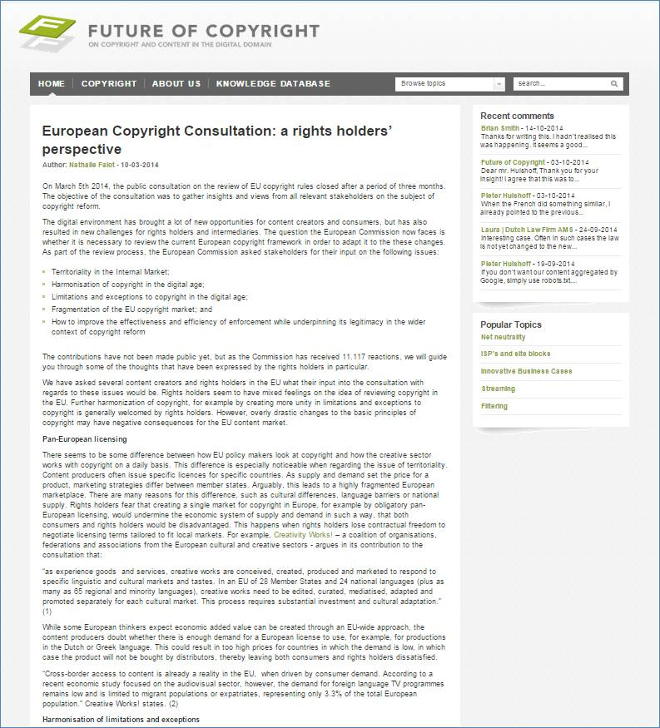
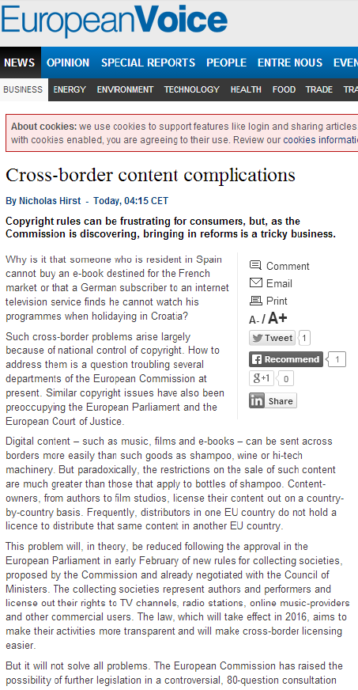
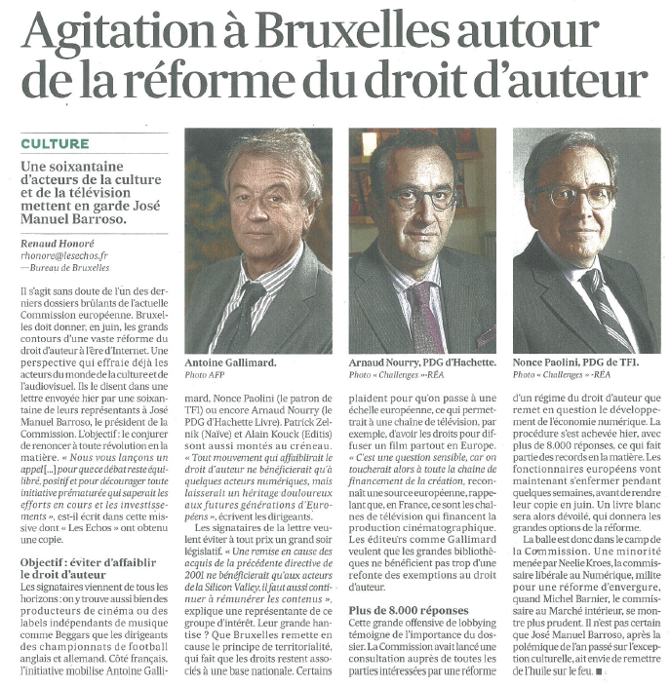
CW! media presence

Slide 18
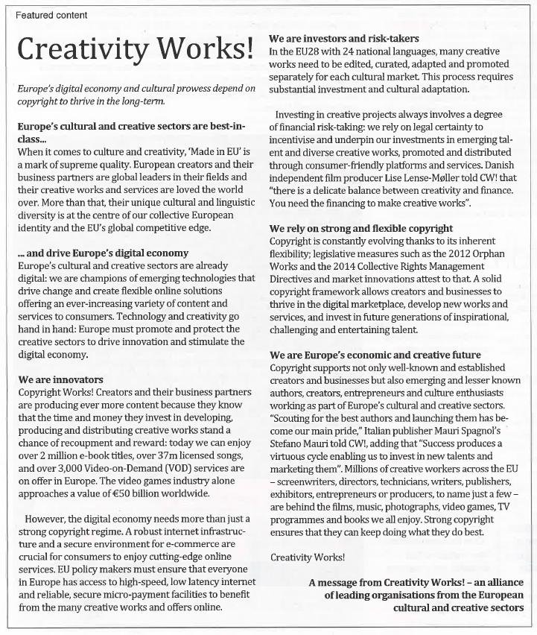
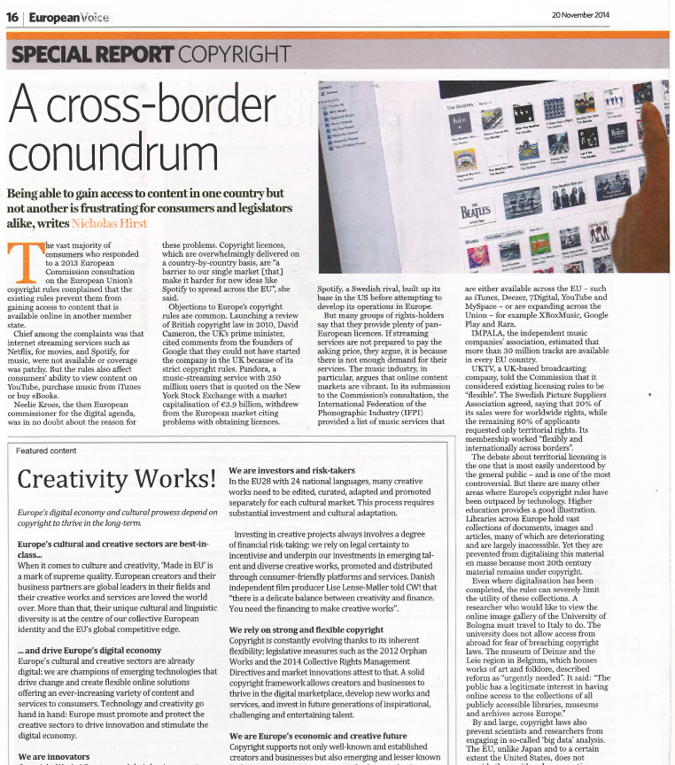
CW! media presence

Slide 19
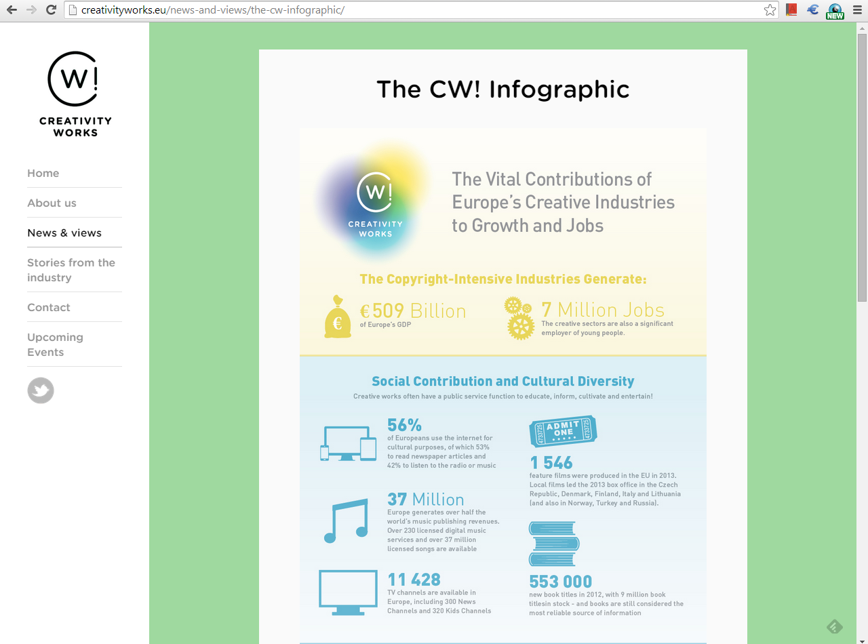
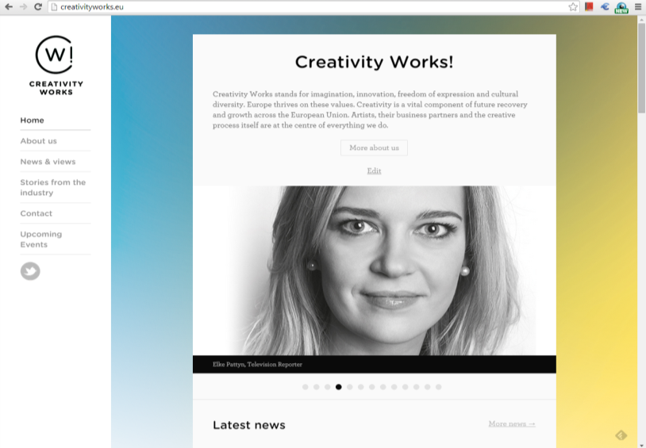
CW! branding and messaging

Slide 20
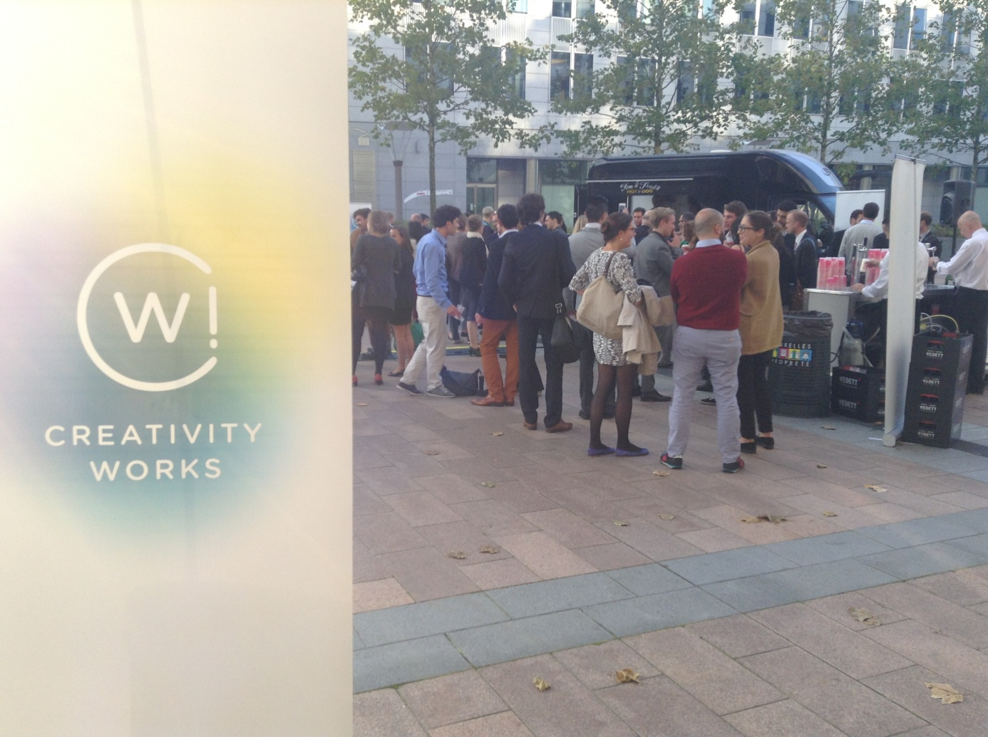
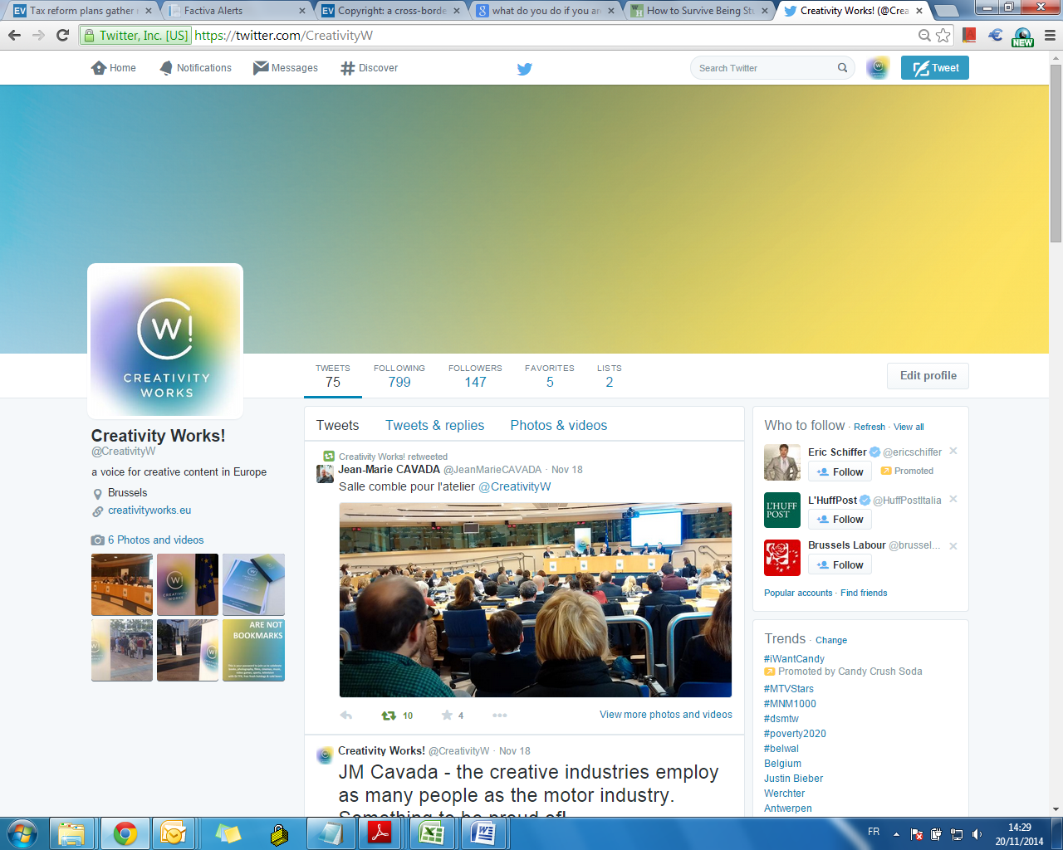
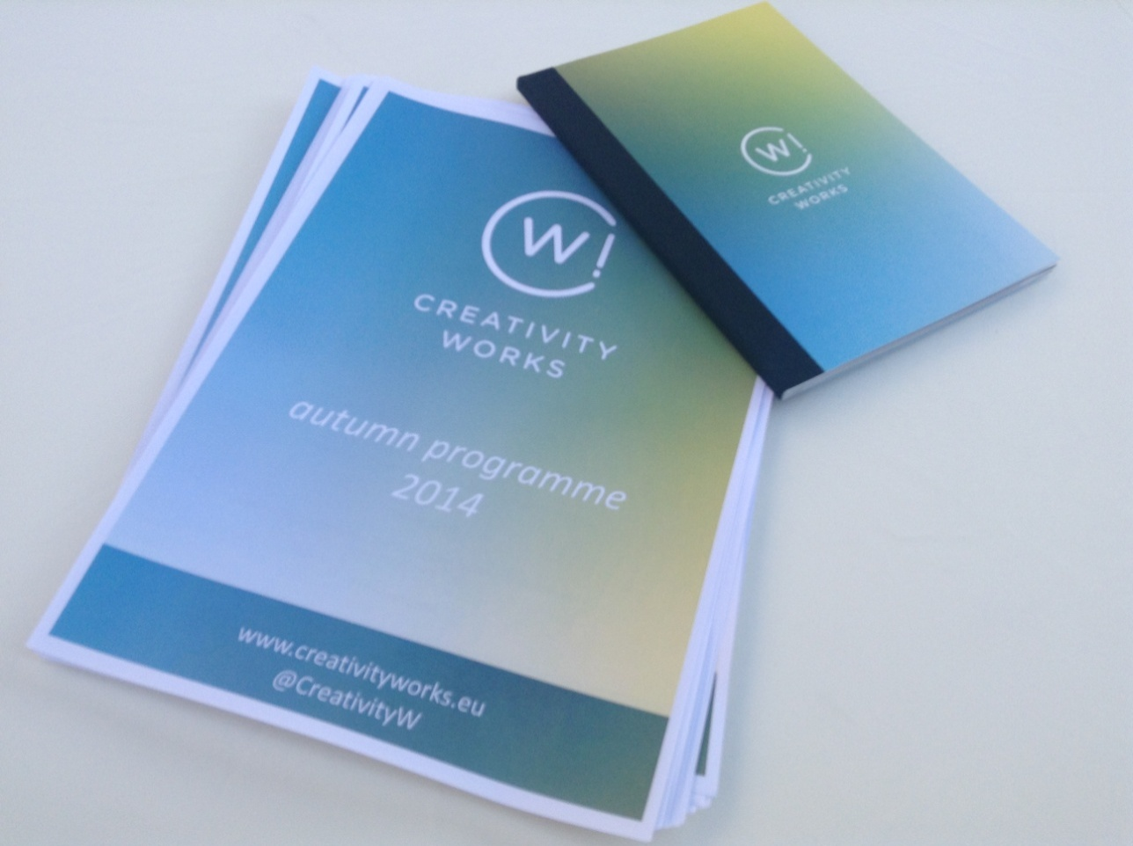
Notes:
Website & twitter. Note the consistent visual identity – important for getting noticed & remembered

Slide 21
CW! twitter strategy
Twitter is used as a channel to share CW! messaging and achievements, not interactive tool at this stage
Any twitter engagement is aimed at directing traffic to the CW! website and increasing followers and the reach of CW!’s activities
CW! has been successful in this regard since starting its twitter handle in March 2014

Slide 22
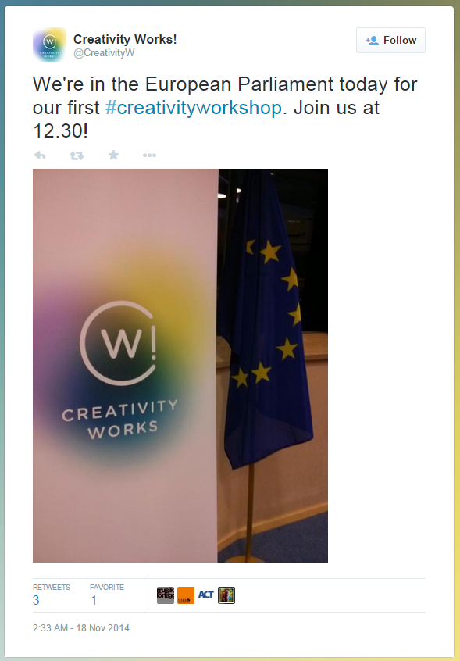
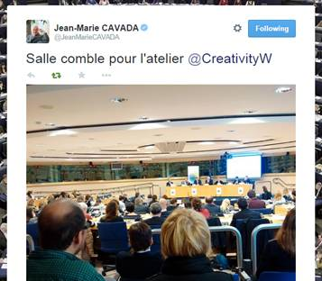
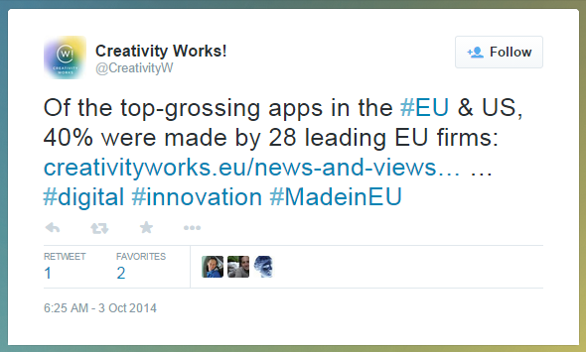
CW! twitter achievements
160 followers and growing: mix of EU policy makers, journalists & industry
88 tweets (since March 2014)
Over 2000 views for latest twitter campaigns

Slide 23
CW! twitter campaigns
Campaign | Date | Total Views
MEDIA: CW! in Les Echos | 14th March | 150
POLICY: World IP Day | 26th April | 441
EVENT: Pop-up! reception | 3rd September | 305
POLICY: EP Hearings | 29th September - 6th October | 2237
POLICY: Vice-President Ansip live chat #AskAnsip | 14th - 15th October | 1350
EVENT: Creativity Workshops POLICY: Commissioner Oettinger live chat | 18th - 20th November | 2264

Slide 24
CW! website
The CW! website and Twitter handle together make up CW!’s digital presence
After every Twitter campaign, visits to CW!’s website spike, leading to more views in other sections
The CW! website is updated regularly to share news about CW! events, CW! member events and activities promoting CW!’s messages, as well as CW! media sucesses and communications material

Slide 25
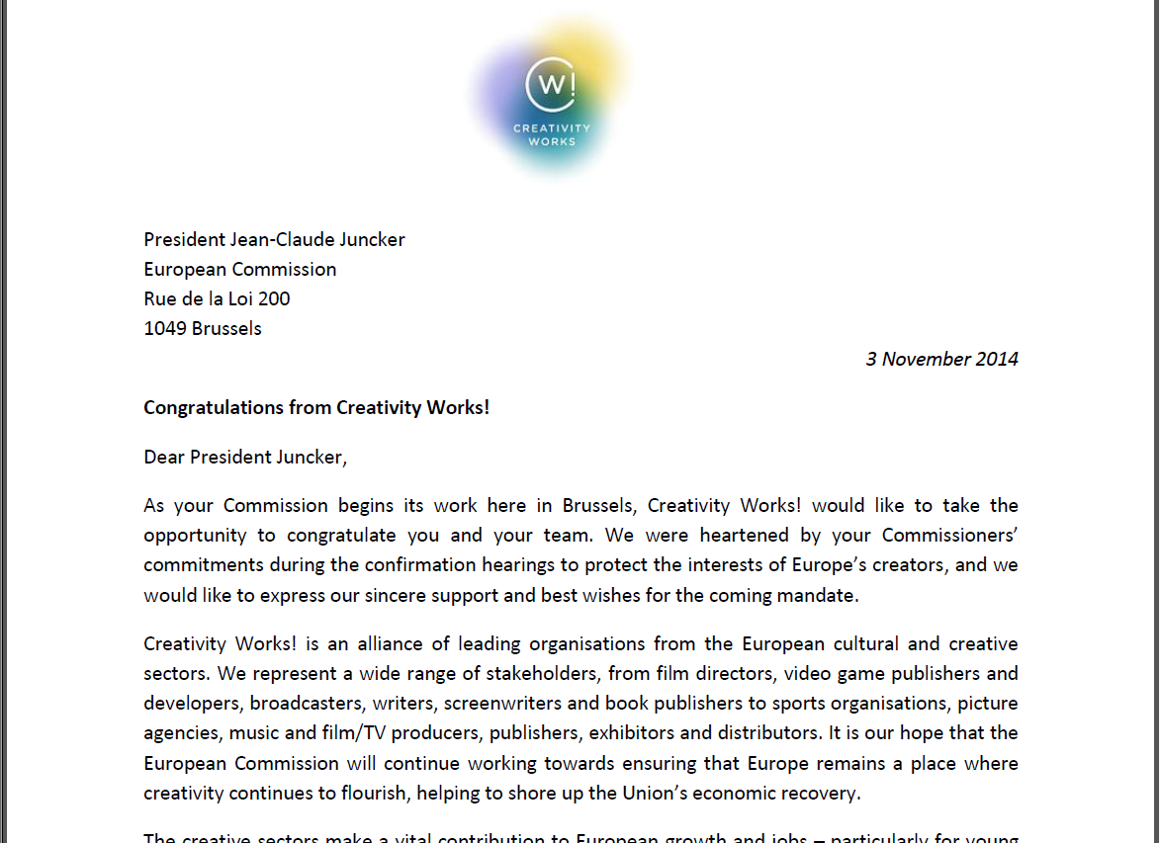
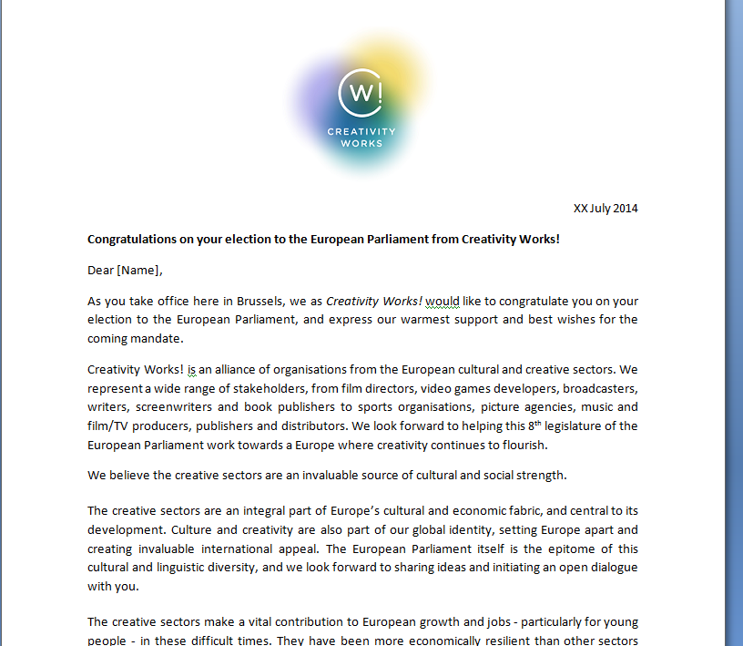
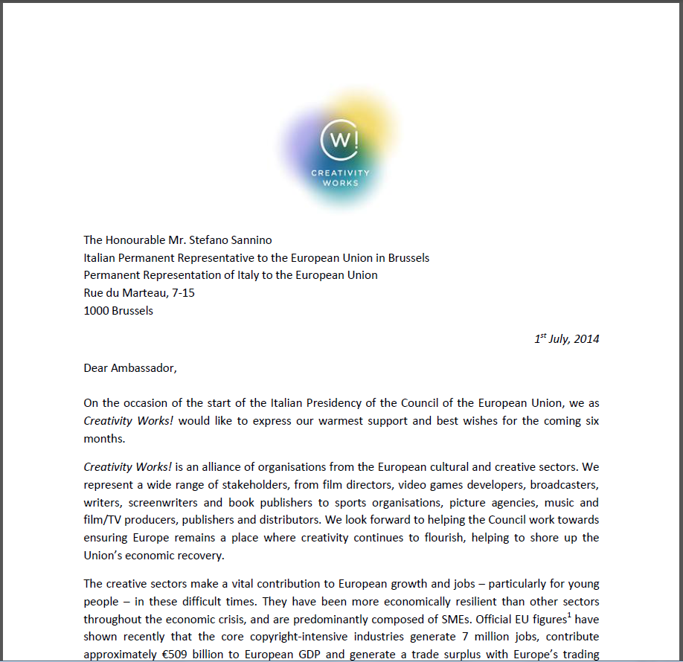
CW! political engagement

Slide 26
Challenges ahead
Don’t be seen as opposing reform
Membership extension?
CW! as a communications platform or more (policy vehicle)?
Notes:
Establish your ‘brand’
Position yourself early

Slide 27
What’s next in 2015
Enhanced twitter strategy
Continued media presence
More events
Adjust the CW! messages to the new environment and present clear asks
... Be part of the solution and drive the political conversation about copyright in the digital age
Notes:
Establish your ‘brand’
Position yourself early

Slide 28
Creativity Works! looks ahead to an eventful and exciting 2015

